Slide 1

IBM data science capstone project
Space x

Slide 2
outline
Executive Summary
Introduction
Methodology
Results
Conclusion
Appendix

Slide 3
Executive summary
SUMMARY OF METHODOLOGIES:
Data collection
Data wrangling
EDA with data visualization and SQL
Building an interactive map with Folium
Building a Dashboard with Plotly dash
Predictive Analysis using machine learning
SUMMARY OF ALL RESULTS:
EDA results
Dashboard analytics
Predictive analysis

Slide 4
introduction
Project background and context
We aimed to predict whether the Falcon 9's first stage would successfully land. SpaceX promotes Falcon 9 launches at a cost of $62 million, which is significantly lower compared to other providers that charge upwards of $165 million. Much of these savings come from SpaceX's ability to reuse the first stage of the rocket. By predicting whether the first stage will land, we can better estimate the overall cost of a launch. This insight could be valuable for other companies looking to compete with SpaceX in bidding for rocket launches.
Problems that needed solving:
What determines whether the rocket will successfully land?
Various rocket-related factors play a significant role in determining the likelihood of a successful landing. Each of these variables impacts the overall success rate of landing.
Additionally, SpaceX needs to meet specific conditions to optimize performance and ensure a high probability of successful landings.

Slide 5

methodology

Slide 6
methodology
Data collection methodology:
SpaceX Rest API and Web Scrapping
Performed Data Wrangling
One Hot Encoding data fields for Machine Learning and dropping irrelevant columns
Performed EDA using visualization and SQL
Plotting : Scatter, Bar, Pie Graphs to show relationships between variables to show patterns of data.
Performed interactive visual analytics using Folium and Plotly Dash
Performed predictive analysis using classification models
building, tuning and evaluating classification model

Slide 7
methodology
The following datasets were collected by:
We analyzed SpaceX launch data retrieved from the SpaceX REST API.
This API provides detailed information about launches, including data on the rocket used, the payload, and specifics related to the launch and landing, including the outcome of the landing.
The objective of our analysis is to predict whether SpaceX will attempt to land the rocket during a given launch.
The SpaceX REST API's base URL starts with api.spacexdata.com/v4/.
Additionally, Wikipedia is another popular source for Falcon 9 launch data, accessible via web scraping using BeautifulSoup.
SpaceX API
Use SpaceX RestAPI
API JSON Response of SpaceX data
Data Normalization into flat files i.e .csv
Web Scrapping
Get HTML Response from Web
Extract data using BeautifulSoup
Normalize data into flat data file such as .csv

Slide 8


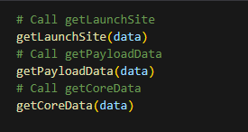

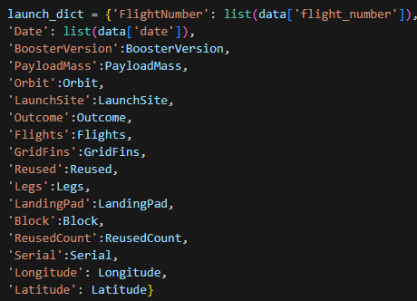

Get Response from SpaceX API
Data Collection – SpaceX API
Use SpaceX REST API
Data Cleaning via filtering
API JSON Response of SpaceX data
Normalized Data into .csv format
2. Response updated to .json format
3. Data Cleaning
4. Combine the columns into a dictionary.
5. Filter Dataframe and export to .csv format

Slide 9
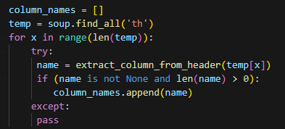
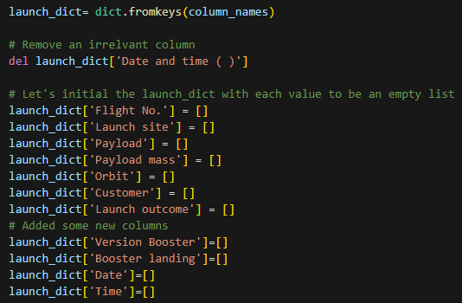
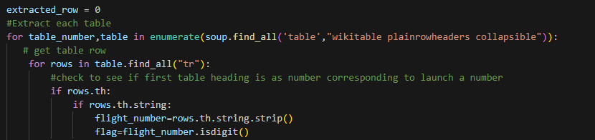
Get Response from HTML
Data Collection – Web Scrapping
Get HTML Response from Web
Extract data via BeautifulSoup
Parse table into dictionary
Normalized Data into .csv format
2. Making BeautifulSoup object
3. Locating tables
4. Get column names
5. Dictionary creation
6. Appending data to keys
7. Convert to DataFrame and export to .csv format

Slide 10
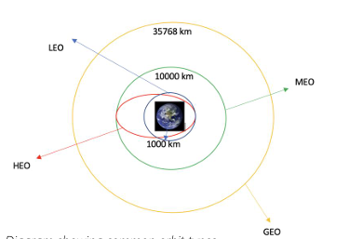
Data wrangling
In the dataset, there are several instances where the booster did not successfully land. In some cases, a landing was attempted but failed due to an accident. For example, "True Ocean" indicates the booster successfully landed in a specific region of the ocean, whereas "False Ocean" means the landing attempt failed in that region. Similarly, "True RTLS" refers to a successful landing on a ground pad, while "False RTLS" indicates failure. "True ASDS" means the booster successfully landed on a drone ship, and "False ASDS" means the landing attempt on the drone ship was unsuccessful. These outcomes were converted into training labels: 1 for successful landings and 0 for unsuccessful ones.
Process:
Calculate the number of launches on each site
Calculate the number of occurrence on each object
Calculate the number and occurrence of mission outcome of the orbits
Create a landing outcome label from Outcome column
Determine the Success Rate
Export to .csv format
SpaceX Orbit types

Slide 11
EDA With data visualization
SCATTER GRAPH:
Scatter plots illustrate how one variable is influenced by another. The connection between the two variables is known as their correlation. Typically, scatter plots feature a large amount of data points, making it easier to visualize trends, patterns, or outliers in the relationship between the variables.
Flight Number VS. Payload Mass
Flight Number VS. Launch Site
Payload VS. Launch Site
Orbit VS. Flight Number
Payload VS. Orbit Type
Orbit VS. Payload Mass
BAR GRAPH:
A bar chart allows for quick and easy comparison of data across different categories. One axis represents the categories, while the other axis shows discrete values, illustrating the relationship between them. Bar charts are particularly useful for showing significant changes in data over time or highlighting differences between groups.
Mean VS. Orbit
LINE GRAPH:
Line graphs are highly effective for clearly displaying data variables and trends, making it easier to understand changes over time. They are also helpful for making predictions about future data points based on trends in the recorded data.
Success Rate VS. Year

Slide 12
EDA With SQL
Executed SQL queries to extract relevant information from the dataset for analysis and exploration.
Displayed the names of the unique launch sites in the space mission
Displayed 5 records where launch sites begin with the string 'KSC’
Displayed the total payload mass carried by boosters launched by NASA (CRS)
Displayed average payload mass carried by booster version F9 v1.1
Listing the date where the successful landing outcome in drone ship was achieved.
Listing the names of the boosters which have success in ground pad and have payload mass greater than 4000 but less than 6000
Listing the total number of successful and failure mission outcomes.
Listing the names of the booster_versions which have carried the maximum payload mass.
Listing the records which will display the month names, successful landing_outcomes in ground pad ,booster versions, launch_site for the months in year 2017
Ranking the count of successful landing_outcomes between the date 2010-06-04 and 2017-03-20 in descending order

Slide 13
Built an interactive map with folium
To visualize the launch data on an interactive map, we plotted the latitude and longitude coordinates of each launch site and marked them with circle markers labeled with the launch site names. We categorized launch outcomes (successes and failures) into classes 0 and 1, using green markers for successful launches and red for failures, and displayed them using a MarkerCluster() for better organization.
We also calculated the distance from each launch site to various landmarks using Haversine’s formula to explore spatial patterns. Lines were drawn on the map to visually represent the distance to these landmarks, helping identify trends related to the launch site’s surroundings.
After ploting distance lines to the proximities, the findings were:
* Are launch sites in close proximity to railways? No
* Are launch sites in close proximity to highways? No
* Are launch sites in close proximity to coastline? Yes
* Do launch sites keep certain distance away from cities? Yes

Slide 14
Built a dashboard with plotly dash
The dashboard is built using the Flask and Dash web frameworks, offering interactive visualizations of the launch data.
Graphs include:
Pie Chart: Displays the total number of launches by specific sites or across all sites, illustrating the relative proportions of different categories of data. The size of the circle can be adjusted to reflect the quantity it represents.
Scatter Graph: Shows the relationship between the launch outcome and the payload mass (kg) for various booster versions. This visualization highlights non-linear patterns and the data range, with clear observation points for determining maximum and minimum values. This type of graph is ideal for identifying trends in two variables.

Slide 15
Predictive analysis (classification)
MODEL CONSTRUCTION
Load dataset: Begin by loading the dataset into NumPy and Pandas for data manipulation and analysis.
Data Transformation: Clean and preprocess the data to make it suitable for model training.
Data Splitting: Divide the dataset into training and test sets to evaluate model performance.
Sample Check: Verify the number of test samples to ensure an appropriate split.
Algorithm Selection: Choose machine learning algorithms that fit the nature of the problem.
Hyperparameter Tuning: Use GridSearchCV to set parameters and find the best combination of hyperparameters for the selected algorithms.
Model Training: Train the models using the training set by fitting the data into the GridSearchCV object.
MODEL EVALUATION
Accuracy Check: Assess the performance of each model by calculating accuracy.
Hyperparameter Results: Retrieve the tuned hyperparameters that work best for each algorithm.
Confusion Matrix: Plot a confusion matrix to visually evaluate the performance of the classification model.
MODEL IMPROVEMENT
Feature Engineering: Refine the features to improve model performance.
Algorithm Tuning: Further fine-tune the algorithms to optimize results.
FINDING THE BEST PERFORMING CLASSIFICATION MODEL
Model Selection: The model with the highest accuracy score is considered the best performing model.
Algorithm Dictionary: The notebook contains a dictionary of algorithms, along with their corresponding scores, to easily compare performance across different models.

Slide 16

RESULTS
EDA results
Dashboard analytics
Predictive analysis

Slide 17
Insights drawn from eda

Slide 18
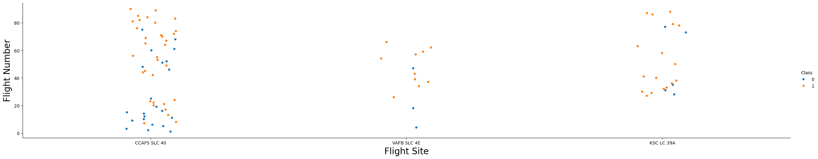
Flight number vs. flight site
Greater the amount of flights at a launch site the higher the success rate

Slide 19
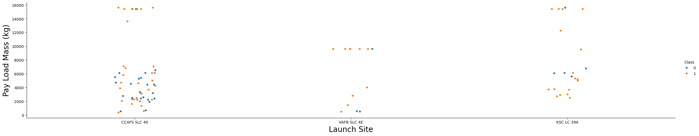
Payload mass vs. launch site
A higher payload mass at the CCAFS SLC 40 launch site correlates with a greater success rate for rocket landings. However, this visualization does not provide a definitive pattern to determine whether the success of the launch is solely dependent on payload mass at this particular launch site. The relationship between payload mass and launch success remains inconclusive based on the current data.

Slide 20
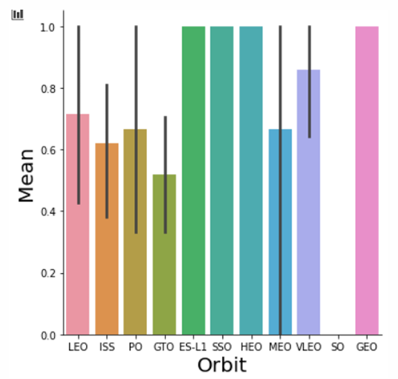
Success rate vs. orbit type
Orbit GEO,HEO,SSO,ES-L1 has the best Success Rate

Slide 21
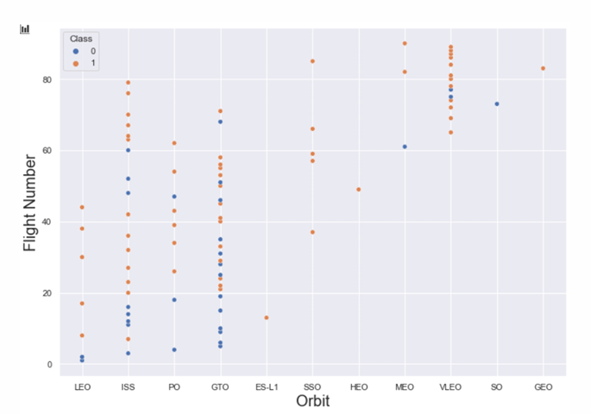
Flight number vs. orbit type
In the LEO (Low Earth Orbit), the data shows a positive correlation between the number of flights and successful landings. As the number of flights increases, the success rate of rocket landings tends to improve. On the other hand, when analyzing GTO (Geostationary Transfer Orbit), there seems to be no clear relationship between the number of flights and landing success, indicating that other factors may play a more significant role in determining the outcome for GTO launches.

Slide 22
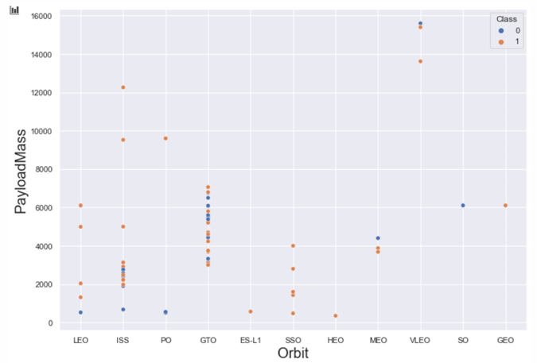
Payload vs. orbit
It can be observed that heavy payloads negatively impact rocket success rates in GTO (Geostationary Transfer Orbit) missions. In contrast, heavier payloads seem to have a positive effect on success rates for GTO and Polar LEO (Low Earth Orbit) missions. This suggests that while increased mass may pose challenges for certain orbits, it can enhance performance in others. Understanding these dynamics is crucial for optimizing launch strategies based on payload weight and orbit type.

Slide 23
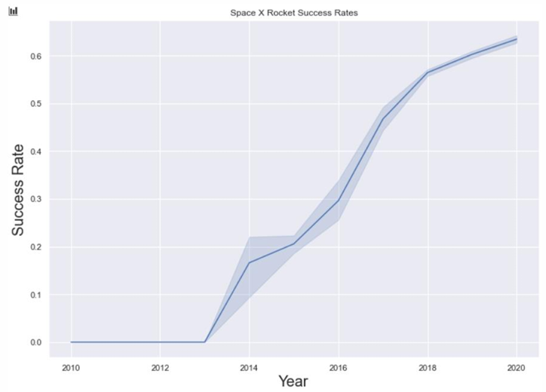
Launch success vs. yearly trend
Success rate has been on a rise since 2013 and is increasing till 2020.

Slide 24

Eda with

Slide 25
UNIQUE launch site names
Unique Launch Sites
CCAFS LC-40
CCAFS SLC-40
CCAFS SLC-40
KSC LC-39A
VAFB SLC-4E
SQL QUERY
SELECT DISTINCT LAUNCH_SITE FROM SPACEXTBL
Query Explanation
The use of the keyword DISTINCT in the SQL query ensures that only unique values from the Launch_Site column in the SPACEXTBL table are returned.

Slide 26
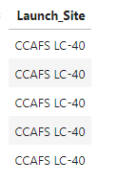
Launch site names begin with ‘CCA’
SQL QUERY
SELECT LAUNCH_SITE from SPACEXTBL where (LAUNCH_SITE) LIKE 'CCA%' LIMIT 5;
Query Explanation
The use of LIMIT 5 in the query limits the results to only five records from the SPACEXTBL table. Additionally, the LIKE keyword, combined with the wildcard ‘CCA%’, specifies that the Launch_Site name must start with CCA, effectively filtering for launch sites that begin with those characters.

Slide 27
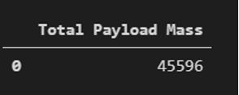
Total Payload Mass by Customer NASA (CRS)
SQL QUERY
SELECT SUM(PAYLOAD_MASS__KG_) FROM SPACEXTBL WHERE Customer = 'NASA (CRS)';
Query Explanation
The SUM function calculates the total value in the PAYLOAD_MASS_KG_ column. The WHERE clause restricts the dataset to include only records associated with Customer NASA (CRS), ensuring that the summation reflects the payload mass specifically for that customer.

Slide 28
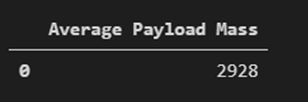
Average Payload Mass carried by booster version F9 v1.1
SQL QUERY
SELECT AVG(PAYLOAD_MASS__KG_) FROM SPACEXTBL WHERE Booster_Version LIKE 'F9 v1.1%';
Query Explanation
The AVG function computes the average value in the PAYLOAD_MASS_KG_ column. The WHERE clause filters the dataset to ensure that calculations are only performed on records corresponding to the Booster_version F9 v1.1. This allows for an accurate average that reflects only the specified booster version's payload mass.

Slide 29

First successful ground landing date
SQL QUERY
SELECT MIN(Date) FROM SPACEXTBL WHERE Landing_Outcome = 'Success (ground pad)'
Query Explanation
Using the function MIN works out the minimum date in the column Date. The WHERE clause filters the dataset to only perform calculations on Landing_Outcome = 'Success (ground pad)'

Slide 30
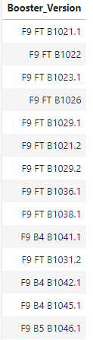
Successful drone ship landing with payload between 4000 and 6000
SQL QUERY
SELECT BOOSTER_VERSION FROM SPACEXTBL WHERE LANDING_OUTCOME = 'Success (drone ship)' AND 4000 < PAYLOAD_MASS__KG_ < 6000;
Query Explanation
Selecting only Booster_Version. The WHERE clause filters the dataset to Landing_Outcome = ‘Success (drone ship)’, the AND clause specifies additional filter conditions Payload_MASS_KG_ > 4000 AND Payload_MASS_KG_ < 6000

Slide 31
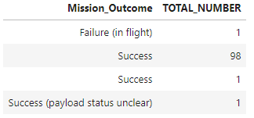
Total Number of Successful and Failure Mission Outcomes
SQL QUERY
SELECT MISSION_OUTCOME, COUNT(MISSION_OUTCOME) AS TOTAL_NUMBER FROM SPACEXTBL GROUP BY MISSION_OUTCOME;
Query Explanation
Using the COUNT function to see all the outcomes of every Mission_Outcome.

Slide 32
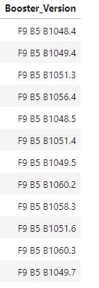
Boosters carried maximum payload
SQL QUERY
SELECT DISTINCT BOOSTER_VERSION FROM SPACEXTBL WHERE PAYLOAD_MASS__KG_ = (SELECT MAX(PAYLOAD_MASS__KG_) FROM SPACEXTBL);
Query Explanation
Using the word DISTINCT in the query means that it will only show Unique values in the Booster_Version column from SPACEXTBL. Followed by a subquery to filter the max payload mass from the table.

Slide 33

2015 LAUNCH RECORDS
SQL QUERY
SELECT substr(Date, 6,2), LANDING_OUTCOME, BOOSTER_VERSION, LAUNCH_SITE FROM SPACEXTBL WHERE Landing_Outcome = 'Failure (drone ship)' AND substr(Date,0,5)='2015'
Query Explanation
This query extracts specific columns (LANDING_OUTCOME, BOOSTER_VERSION, and LAUNCH_SITE) from the SPACEXTBL table, filtering for records where the LANDING_OUTCOME is 'Failure (drone ship)'. It also uses the substr function to extract parts of the Date column: the month (substr(Date, 6, 2)) and checks if the year (substr(Date, 0, 5)) is '2015'.

Slide 34
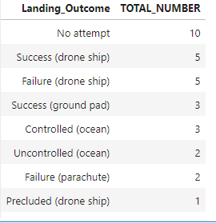
Rank success count between 2010-06-04 and 2017-03-20
SQL QUERY
SELECT LANDING_OUTCOME, COUNT(LANDING_OUTCOME) AS TOTAL_NUMBER FROM SPACEXTBL WHERE DATE BETWEEN '2010-06-04' AND '2017-03-20’ GROUP BY LANDING_OUTCOME ORDER BY TOTAL_NUMBER DESC
Query Explanation
Function COUNT counts records in column. WHERE filters data, LIKE (wildcard), AND (conditions), GROUPING BY Landing Outcome in descending order.

Slide 35
Interactive map with folium
Launch site proximities analysis

Slide 36
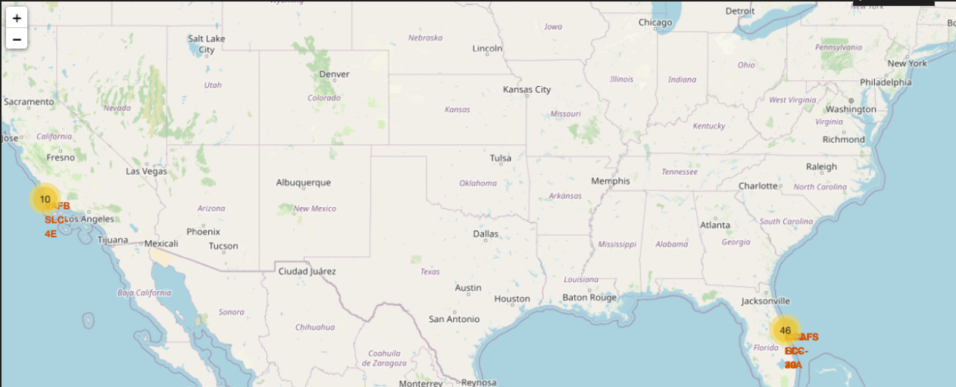
All launch sites global map markers
We can see that the SpaceX launch sites are in the United States of America coasts. Florida and California

Slide 37
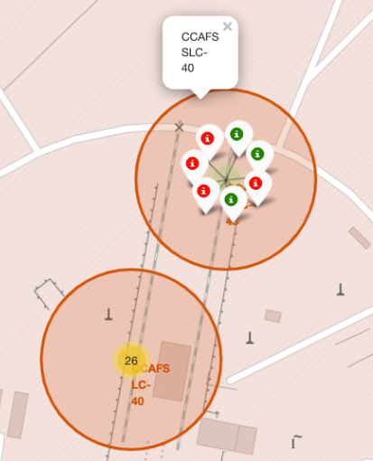
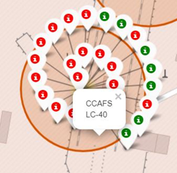
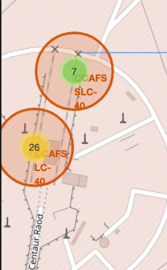
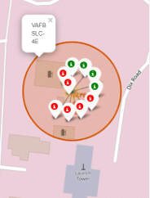
Color Labelled Markers
Florida launch sites
Cali launch sites

Slide 38
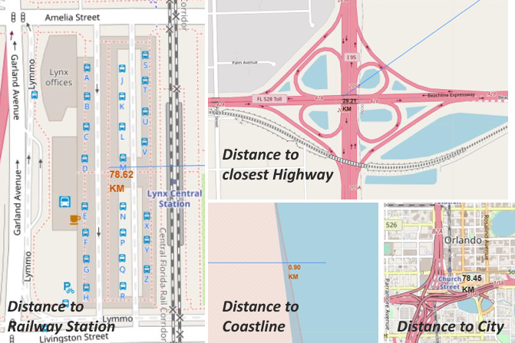
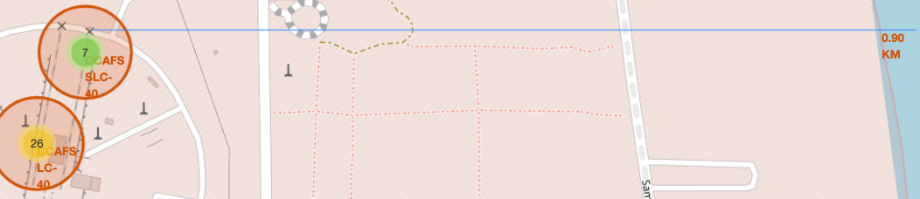
launch site to its proximities such as railway, highway, coastline, with distance calculated
Distance to coast

Slide 39

DASHBOARD WITH PLOTLY DASH

Slide 40
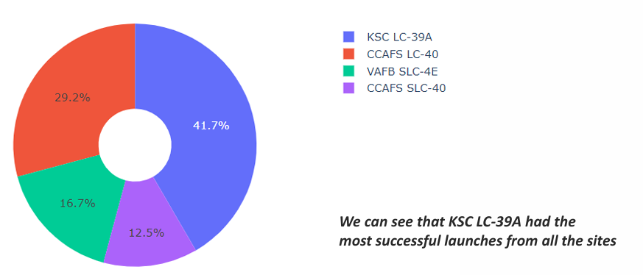
DASHBOARD–Pie chart showing the success percentage achieved by each launch site

Slide 41
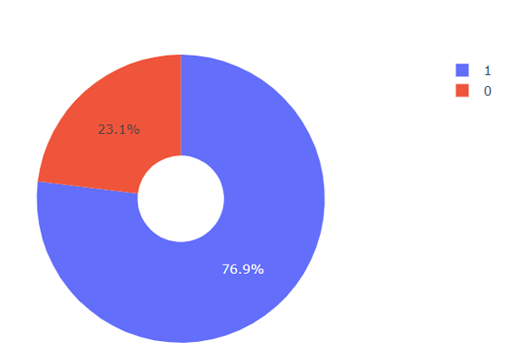
DASHBOARD–pie chart for the launch site with highest launch success ratio
KSC LC-39A achieved a 76.9% success rate while getting a 23.1% failure rate

Slide 42
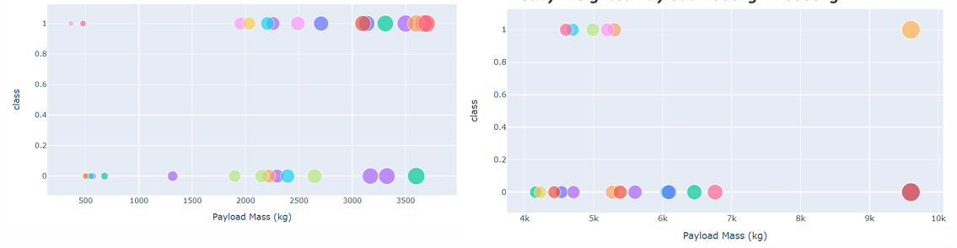
Payload vs. Launch Outcome scatter plot for all sites, with different payload selected in the range slider
Low Weighted payload scatter plot
High Weighted payload scatter plot
The success rates for low weighted payloads is higher than the heavy weighted payload

Slide 43
DASHBOARD–pie chart for the launch site with highest launch success ratio
KSC LC-39A achieved a 76.9% success rate while getting a 23.1% failure rate

Slide 44

Predictive analysis (classification)

Slide 45
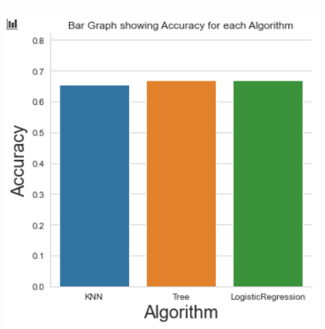
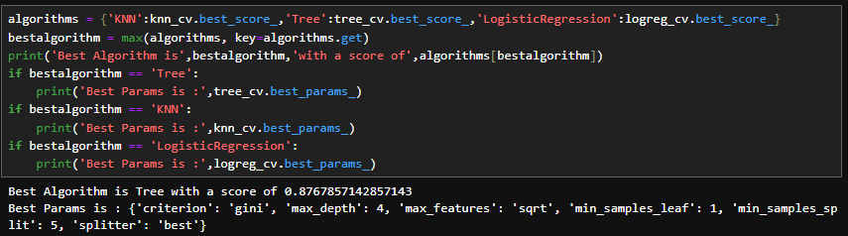
Classification accuracy
As you can see, the accuracy is remarkably close, but we do have a winner—it all comes down to the decimal points!
The tree algorithm is the winner! With a score of 87.76% and accuracy of 83.33% on test data.

Slide 46
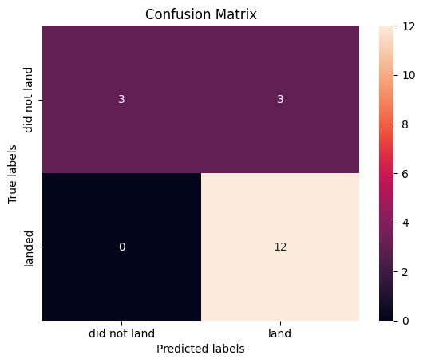
Confusion matrix – decision tree
In summary:
The model predicted 15 out of 18 cases correctly.
The model made 3 incorrect predictions, all in the form of false positives (where it thought the rocket would land but it didn’t).
The absence of false negatives suggests the model didn’t miss any actual landings.

Slide 47

conclusion
The Tree Classifier Algorithm stands out as the most effective machine learning technique for this dataset.
Lighter payloads tend to show better performance compared to heavier payloads.
The success rates of SpaceX launches appear to increase over the years, indicating continuous improvement and eventual launch perfection.
Among all the launch sites, KSC LC-39A has recorded the highest number of successful launches.
The GEO, HEO, SSO, and ES-L1 orbits demonstrate the best success rates for launches.

Slide 48
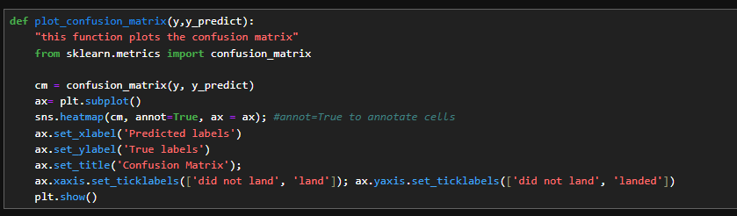
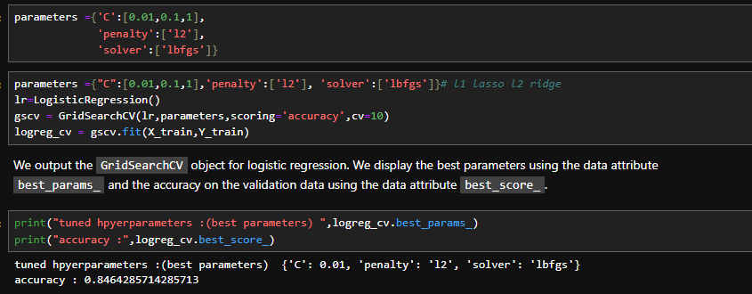
appendix

Slide 49
THANK YOU
Eesha Qureshi
eesha_qureshi@outlook.com

